Slide 1

A comprehensive review on plant disease detection using machine learning and deep learning techniques

Slide 2
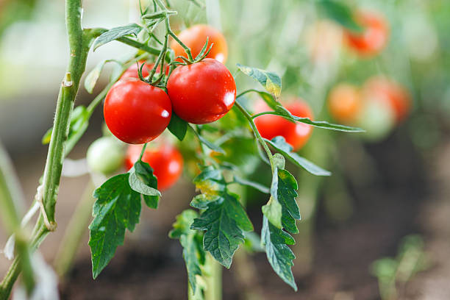
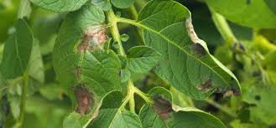
Team Members Name: Venkata Naga Surya Pavan Sai Puvvada Student ID: 700738988 Name: Teja Sai Kallepalli Student ID: 700740435

Slide 3
ROLES & RESPONSIBILITIES
Teja Sai: Algorithm Implementation and Python development
Naga Surya: Dataset Collection and Web page development

Slide 4
MOTIVATION
Plant sicknesses pose a totally devastating hazard to the agriculture enterprise and have the capacity to push the entire human society into hunger if not detected early. With the implementation of gadget mastering fashions withinside the area of plant pathology, the detection of plant sicknesses becomes simpler and inexpensive assisting many farmers withinside the well-timed detection of plant sicknesses, stopping wastage of flowers and defensive the transmission of sicknesses from diseased to wholesome flowers.
Agriculture, being a large contributor to the world’s financial system, is the important thing source of food, earnings, and employment. In India, as in different low and middle-earnings countries, wherein a widespread variety of farmers exist, agriculture contributes 18% of the nation’s learnings and boosts the employment charge to 53%.
For the past three years, the gross value added via way of means of agriculture to the country’s overall financial system has accelerated from 17.6% to 20.2%. This quarter offers the very best percentage of financial growth. Hence, the impact of plant ailment and infections from pests on agriculture might also additionally influence the world’s financial system via way of means of decreasing the manufacturing quality of food.

Slide 5
OBJECTIVES
There are three objectives of the proposing methodology:
To develop a prototype for a plant disease detection system.
To apply image processing techniques to identify the disease pattern.
Use machine learning algorithms to predict disease.

Slide 6
RELATED WORK
Plant diseases regularly produce disease outbreaks that result in famine and widespread death.
Some crop cultivation has been stopped due to the catastrophic consequences of plant diseases
The primary strategy used in practice for detecting and identifying plant diseases is expert observation with the unaided eye.
To develop a one-stop shop for all information needs connected to agriculture for an Indian farmer, Farmers' Portal is an effort in that aim.
A farmer will be able to get all pertinent information on specific topics pertaining to their village, block, district, or state once they are on the Farmers' Portal.
The farmer phones this service center through the farmers portal and gets all his questions answered.
This has the drawback that nobody at the help center can see the precise issue the farmer is having. Because they struggle to fully grasp the disease's severity, they occasionally identify diseases incorrectly.

Slide 7
PROBLEM STATEMENT
India is known to be the world's largest producer of pulses, rice, wheat, spices and spice products. Farmer's economic growth depends on the quality of the products that they produce, which relies on the plant's growth and the yield they get. Therefore, in field of agriculture, detection of disease in plants plays an instrumental role. Plants are highly prone to diseases that affect the growth of the plant which in turn affects the ecology of the farmer.
In order to detect a plant disease at very initial stage, use of automatic disease detection technique is advantageous. The symptoms of plant diseases are conspicuous in different parts of a plant such as leaves, etc. Manual detection of plant disease using leaf images is a tedious job. Hence, it is required to develop computational methods which will make the process of disease detection and classification using leaf images automatic.

Slide 8
PROPSED SOLUTION
Making computer-based vision systems that use plant alternatives that are retrieved from images as input parameters to various classifier systems involves different methodologies. A website with an image recognition method that accepts the image as input and shows the disease diagnosed by the ML process using the image has been established to accept user input.
I. IMAGE CAPTURE
A typical image database contains 40 photographs from the plat leaf Research Center for each class.
Picture pre-processing is the process of converting an image from RGB to L*a*b color space so that it can be used as the basis for training and testing an algorithm.
II. SEGMENTATION OF IMAGES
K stands for clustering partitions or creating the data clusters that are closest to the centroid.
The centroid represents the mathematical meaning of all cluster points.
After determining the nearest centroid, the new centroid is computed for each division or cluster.
Until k-clusters are determined, and no further changes are possible, the position and number of the centroid are altered incrementally.
Reduced by arithmetic mean which is least square estimator.

Slide 9
III. FEATURE EXTRACTION
Each disease has a unique characteristic that can be used to identify it. All symptoms that can be noticed on the leaves of the plat leaf crop are compiled, and the characteristic of the illness is then extracted.
Three different types of features, including area, the grey level co-occurrence matrix (GLCM), and color moment, are retrieved in this article.
IV. FEATURE SELECTION USING GENETIC ALGORITHM
The feature selection strategy improves classification accuracy and speed.
The following steps define the general structure of the genetic algorithm:
1) GA first generates a random beginning population.
2) GA then performs the new population's sequence construction. The algorithm employs the members of the current generation to create the subsequent population and then takes the following actions:
Each participant receives a score based on their level of fitness.
It scales each participant's raw fitness scores to create a more useful range of results.
GA chooses the members based on their fitness.
Members with less physical fitness are transferred to the following demographic F. Classification There are two categories for all photographs of the plat leaf blast and brown spot.

Slide 10
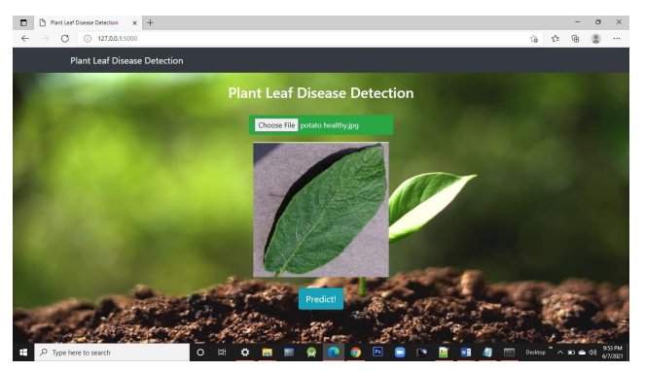
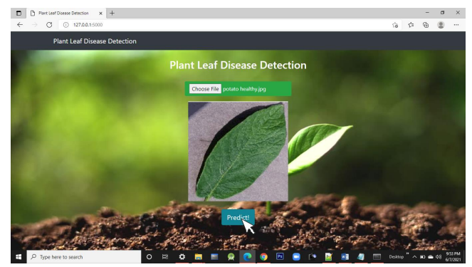
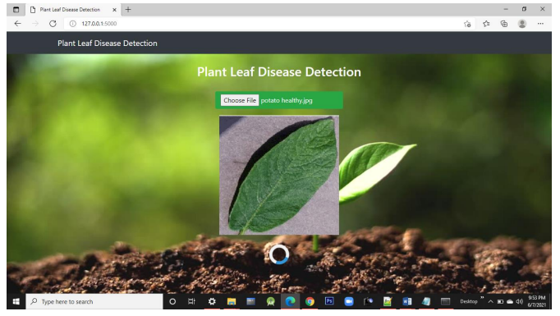
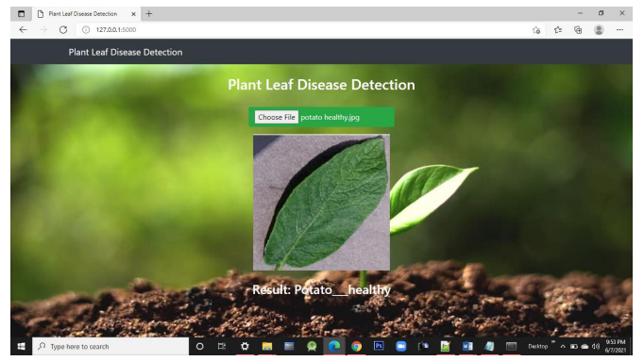
RESULTS

Slide 11
CONCLUSION
A technique for automatically detecting plat leaf disease utilizing many parameters, including area, GLCM, and color moment. Genetic algorithms are utilized to choose the retrieved characteristics, resulting in decreased dimensionality and reduced computational complexity.
Two different types of classifiers are employed to divide the photos into the diseased (plat leaf blast, brown spot) and non-diseased classes. demonstrates the detection precision for each feature using the CNN and SVM classifiers.
With CNN classification and 88.6% with SVM, a 13-D GLCM feature that depicts the image's grey level cooccurrence matrix provides the greatest detection accuracy of 96.75%.
With an execution time of 0.002287 seconds, the color moment feature has an accuracy of 95.5% when classified with CNN and 87.25% when classified with SVM.
The area feature, which describes the morphology of the diseased part of the leaf, has an accuracy of 96.5% and 95.25% when classified with CNN and SVM, respectively.
It demonstrates that for all retrieved features, CNN has greater detection accuracy than SVM. The chart also makes it clear that local features play a smaller role in disease detection.

Slide 12
REFERENCES
1. A comprehensive review on detection of plant disease using machine learning and deep learning approaches
https://www.sciencedirect.com/science/article/pii/S2665917422000757
2. F. Qin, D. Liu, B. Sun, L. Ruan, Z. Ma, H. Wang Identification of alfalfa leaf diseases using image recognition technology PLoS One, 11 (12) (2016) Article ID e0168274
https://journals.plos.org/plosone/article?id=10.1371/journal.pone.0168274
3. C.K. Sunil, C.D. Jaidhar, N. Patil Cardamom plant disease detection approach using Efficient NetV2 IEEE Access, vol. 10 (2021), pp. 789-804, 10.1109/ACCESS.2021.3138920 2021
https://ieeexplore.ieee.org/ielx7/6287639/9668973/09663367
4. S.P. Mohanty, D.P. Hughes, M. Salathé Using deep learning for image-based plant disease detection Front. Plant Sci., 7 (2016) article 1419
https://www.frontiersin.org/articles/10.3389/fpls.2016.01419/full
5. M. Arsenovic, M. Karanovic, S. Sladojevic, A. Anderla, D. Stefanovic Solving current limitations of deep learning-based approaches for plant disease detection Symmetry, 11 (2019), p. 939
https://www.researchgate.net/publication/334561654_Solving_Current_Limitations_of_Deep_Learning_Based_Approaches_for_Plant_Disease_Detection
6. Performance of deep learning vs machine learning in plant leaf disease detection
https://www.sciencedirect.com/science/article/abs/pii/S0141933120307626

Slide 13
THANK YOU

